Slide 1
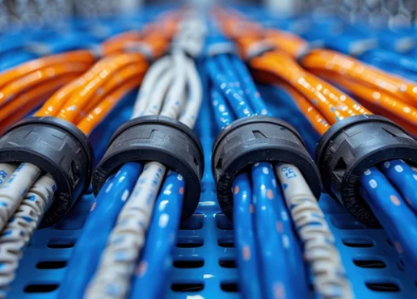
Proposal & Quotation for Wire Management System Installation
Company Name: LECTRON ELECTRICALS
Client Name: Carl Duncan
Date: 14/08/2024
Prepared By: Zivoo Ouma.
0790825478

Slide 2
Introduction
Project Overview:
This proposal outlines the design, supply, and installation of a wire management system using high-quality wire trunks to organize and protect electrical wiring throughout Carl’s house.

Slide 3
Scope of Work
Project Phases:
1. Assessment & Planning: Conduct site surveys and assess the wiring requirements.
2. Design & Layout: Design the wire management system, specifying the placement of trunks.
3. Supply & Installation: Supply the required materials and install the wire trunks.
4. Testing & Handover: Perform system testing and hand over the project.

Slide 4
Materials & Equipment
Material List:
- Wire Trunks
- Adhesive glue
- Junction Boxes
- Cable Ties
- Fasteners
Specifications:
Provide the technical specifications or standards the materials meet.

Slide 5
Cost Estimate
Item | Description | Quantity | Unit Price | Total Cost
Wire Trunks | High-quality PVC wire trunks, [16mm x 25mm] | 3 | 580 | 1740
Adhesive glue | Sestic glue (50 ml) | 4 | 150 | 600
Miscellaneous | Cable ties. | 1 | 160 | 160
Installation Labor | Installation of wire trunks & accessories |  |  | 1500
TOTAL |  |  |  | 26500

Slide 6
Project Timeline
Start Date: 12/08/2024
Completion Date: 18/08/2024
Milestones:
- Site Survey: 13/08/2024
- Installation Start: 17/04/2024
- Testing & Handover: 18/04/2024

Slide 7
Terms & Conditions
Payment Terms:
- 50% advance upon approval, 50% upon completion.
Warranty:
- 1 month on workmanship.
Validity:
- This quotation is valid for 30 days from the proposal date.

Slide 8
Approval & Acceptance
Client Signature:
Name: _____________________
Date: _____________________
Prepared By:
Name: Zivoo Ouma
Date: 14/08/2024

Slide 9
Contact Information
LECTRON ELECTRICALS
Address: Nairobi, Kenya.
Phone: 0790825478.
Email: zivoouma@gmail.com

